Slide 1

Estimating the Circuit De-obfuscation Runtime based on Learning Methods
Third Presentation

Slide 2
Main Questions

Slide 3
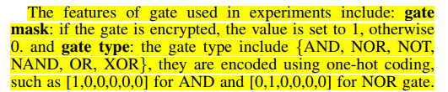
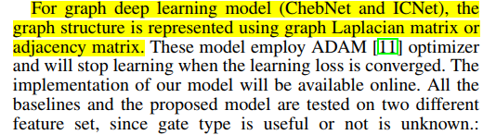
Main questions
In this section, the authors declared each gate (node in graph representation) has two features. These features are gate mask and gate type. However, there isn’t any information about gate mask in bench files. On the other hand, Is there any library or module to obtain the mentioned features from bench files?
In this section, the authors declared the graph structure is represented using graph Laplacian matrix or adjacency matrix. We already have bench files of some circuits but we couldn’t represent them to adjacency matrix. Is there any library or module to obtain adjacency matrix from bench files? I already converted bench file to CNF but I’m not sure that the CNF representation is same with adjacency matrix
Notes:
Infertility : inability of couples to achieve pregnancy in one year.
It can have adverse effects on family’s aspects of life.
About 30-50% of infertility cases are due to male factor.
Semen analysis is the first step in diagnosis and treatment of male infertility.
Microscopic parts of semen analysis assess characteristics of sperm cells.

Slide 4
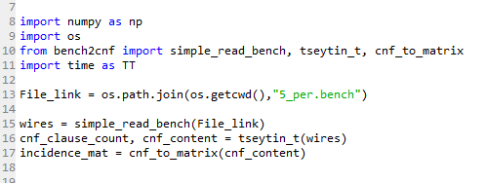
Main questions
According to my code, we could extract CNF representation as a matrix called incidence mat. However, we still have ambiguities about it.
Could we use CNF matrix as an adjacency matrix for a GNN model?
How to transfer CNF representation to adjacency matrix
Notes:
Infertility : inability of couples to achieve pregnancy in one year.
It can have adverse effects on family’s aspects of life.
About 30-50% of infertility cases are due to male factor.
Semen analysis is the first step in diagnosis and treatment of male infertility.
Microscopic parts of semen analysis assess characteristics of sperm cells.

